Slide 1






HANOI UNIVERSITY
BACKEND
HANU CHATBOT
UNLEASHING CHATGPT IN DOMAIN-SPECIFIC KNOWLEDGE
Presenter: Dang Quynh Trang
ID: 2001040208
Faculty: Information Technology
Mentor: Nguyen Xuan Thang

Slide 2


CONTENT
01
02
03
04
Introduction
Objectives
Scope and Limitations
System Architecture
05
06
07
08
System Workflow
DEMO
Conclusion
Q&A

Slide 3



INTRODUCTION
01
Background: AI inventions such as Large Language Models (LLMs) reshape how we interact with digital information, improving learning experiences.
02
Problem: Lack of domain expertise and bias in their training data create hallucinations, hindering accurate and contextually relevant responses.
03
Proposed solution: Develop a robust backend system to provide ChatGPT access to domain-specific knowledge, enabling in-depth responses to be returned.

Slide 4
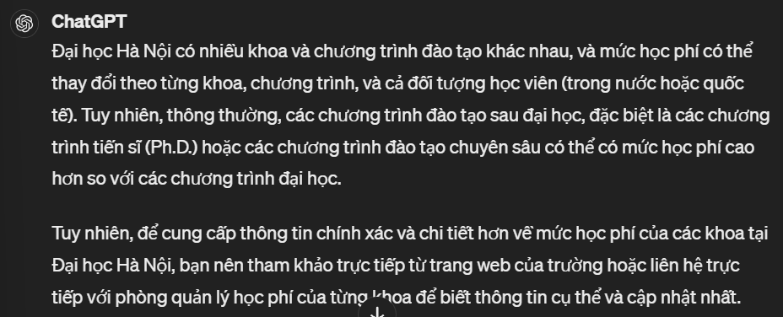

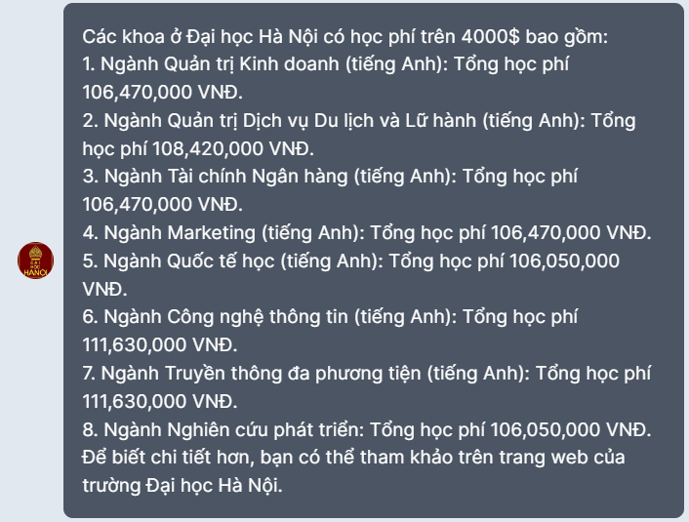



Slide 5



AVAILABLE APPROACHES
Fine-tuning LLMs on domain-specific data:
Improves contextual understanding
Resource-intensive, difficult to update with new information
Knowledge Grounding
Retrieving relevant information from external knowledge bases
May add latency and necessitate database upkeep

Slide 6


OBJECTIVES
Investigate data ingestion, data processing, data retrieval and data integration mechanisms
Develop a robust backend system to integrate Hanoi University's specialized knowledge with ChatGPT model

Slide 7



SCOPE & LIMITATIONS
Focus on developing a backend system to provide necessary Hanoi University domain-specific knowledge, with frontend pulling ChatGPT responses.
Limited to Hanoi University's domain-specific data, potentially limiting broader applicability.

Slide 8


SYSTEM ARCHITECTURE
01
Document injection & preprocessing pipeline: Ingests HANU internal documents & performs text chunking
02
Embedding generator: Converts text → vector representations holding semantic meanings of the text
03
Vector database: Optimized to store and retrieve vectors, uses indexing techniques for fast similarity search
HANU CHATBOT
04
Vector search and retrieval: Retrieves relevant document chunks whose embeddings similar to that of the user query
05
API Development: Implements RESTful API for communication between FE and BE components

Slide 9
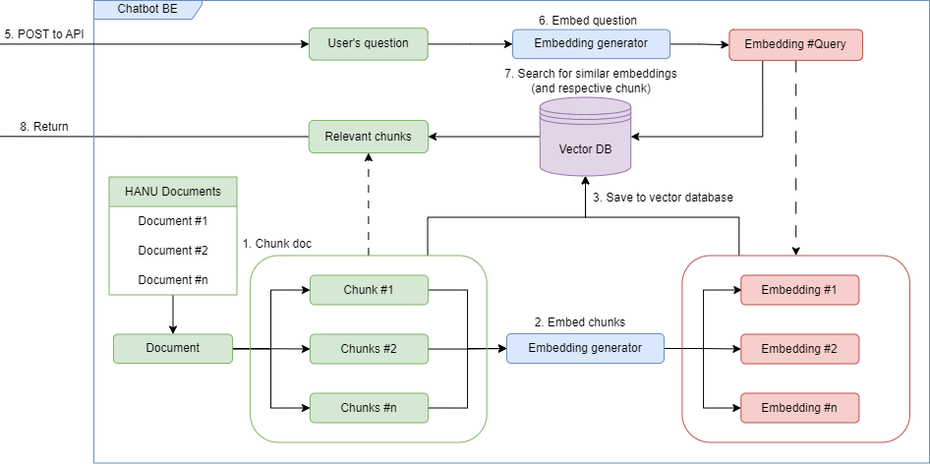
BACKEND WORKFLOW

Slide 10
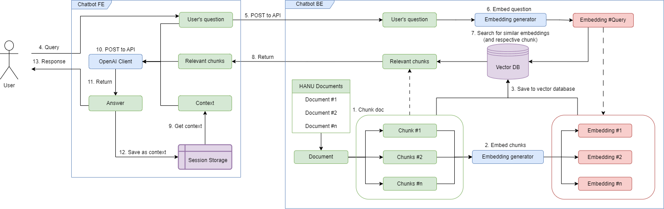
SYSTEM WORKFLOW

Slide 11





TECHNOLOGY
Python PL & libraries
Flask framework
PostgreSQL database
Git & Github
Serves as the development platform for the backend system.
Mediates between the FE and BE systems, enable API integration
Utilized pgvector extension and ivfflat index for vector storage and retrieval
Facilitates cooperation, code management, and version tracking

Slide 12
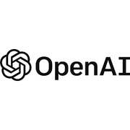



TECHNOLOGY
PYTHON LIBRARIES
OpenAI library
Psycopg2 library
Pgvector library
Pandas library
Facilitates communication with powerful language models.
Interfaces Python with PostgreSQL database for data management.
Connects the backend system to PostgreSQL database through vector extension.
Handles complex data structures and manipulation within the project.

Slide 13


Slide 14
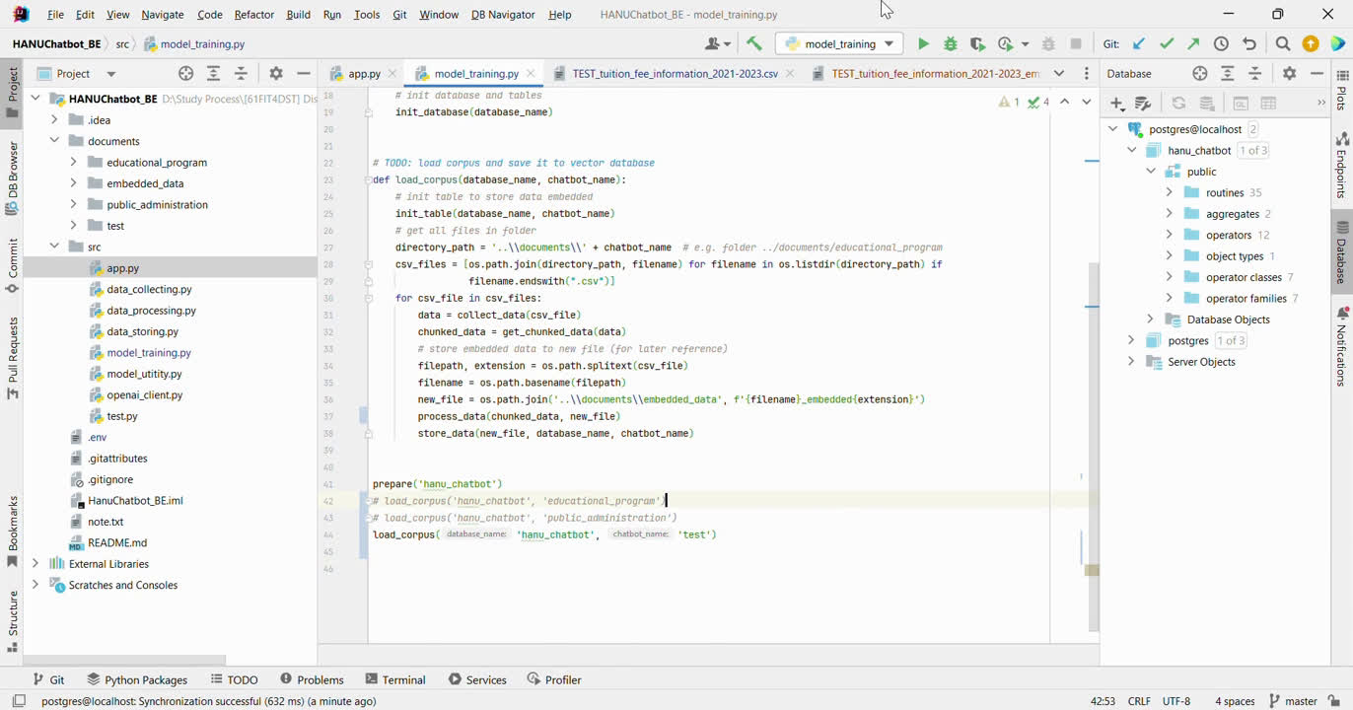

Slide 15
CONCLUSION
01
Result: The system successfully integrated Hanoi University’s domain-oriented knowledge with ChatGPT, providing in-depth answers for most use cases
02
Constraints:
Sometimes ranking the phrases’ occurrence over the relevance
Limited knowledge domains
03
Future Improvements:
Authentication and authorization
User’s context retrieved within the database
Diverse types of data inputs (images, PDF files, ...)

Slide 16







HANOI UNIVERSITY
QUESTION AND ANSWER

